Slide 1


“DMC Analytics” Data Driven Decision-making Business Intelligence Dashboard
Will Patton
Connor Jennings
Eric Pettersen
Zackory Taylor

Slide 2

“Data Analytics” A new consulting offering for DMDII / DMC
Goal: Optimize Assets, Systems and Business Results

Slide 3



“Data Analytics – Value Proposition for DMC Participants
Companies & Organizations
Hackers, Programmers, Analysts & Data Scientists
Laboratory for Learning, Collaboration and Engagement (with Manufacturing Leaders)
Community of Practitioners Experts and Enthusiasts
To
Access to important real world business problems, decision-makers and big data
OPPORTUNITIES
TODAY
Reactive Operational Troubleshooting
TOMORROW
Enlightened Data-Driven Decision-making
Impact the future of Manufacturing
Propose and work on important projects
Make money and build your resume

Slide 4
Myriad of Options – Tailored to Client Preferences
Asset Productivity
Cost of Quality
Optimizing Tool Life
Benchmarking
Machine Operator Incentive Programs
Energy Efficiency and Cost

Slide 5
Appendix

Slide 6
Concept – DMC Analytics Create Business Intelligence Dashboard for Data-driven Decision-making
Get Splits
Create portfolio of BI charts, data and views
Manageable Chunks
Plant-level Attributes
Machine Attributes
Machine Utilization Measures
Energy Consumption Measures
Etc.
Monthly
Weekly
Daily
____
____
____
____
IMPORTS
24GB
SQL

Slide 7

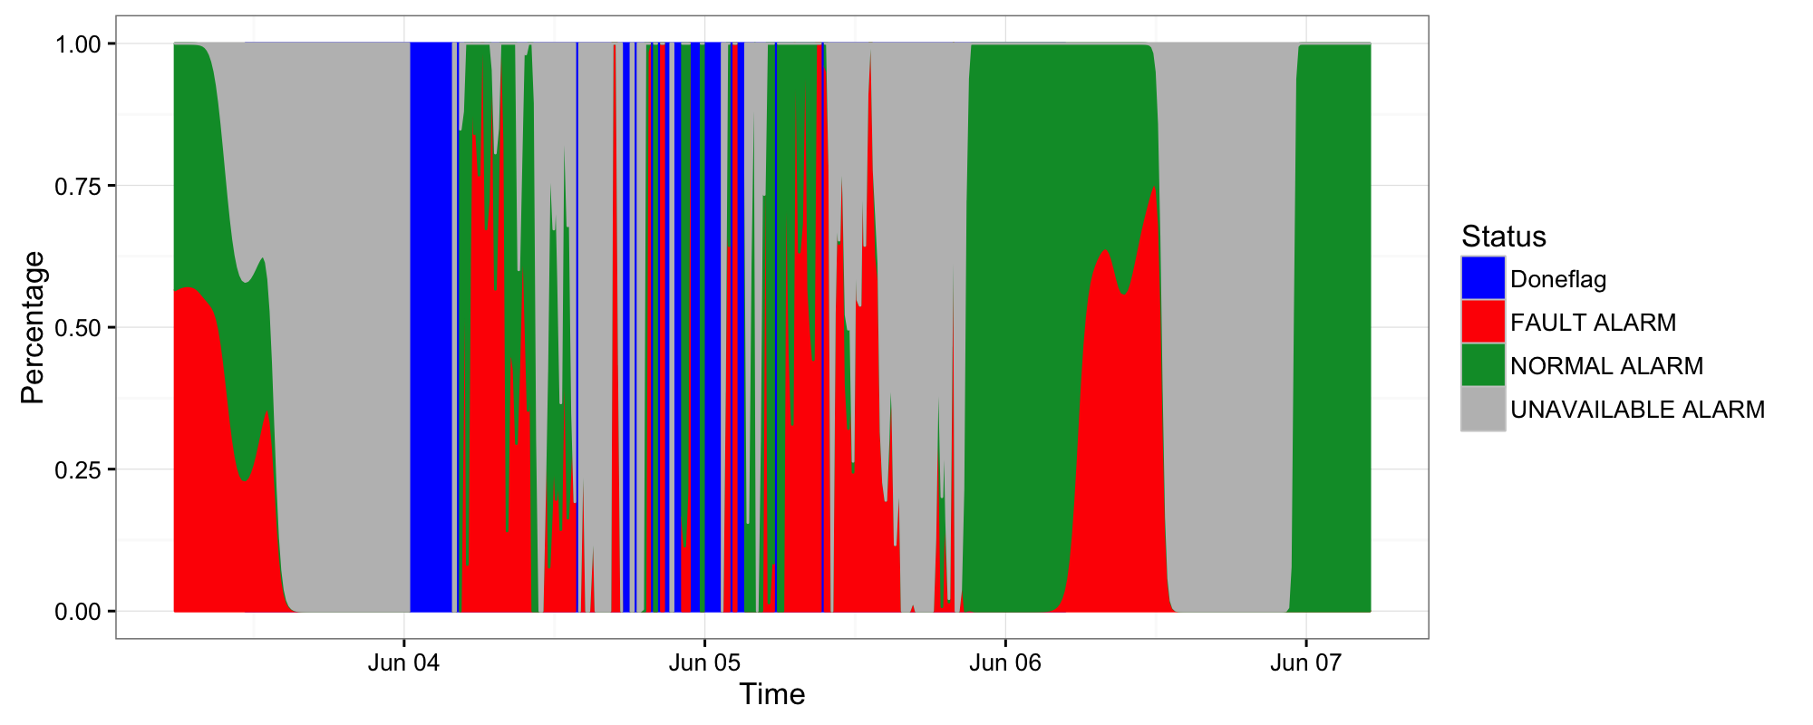
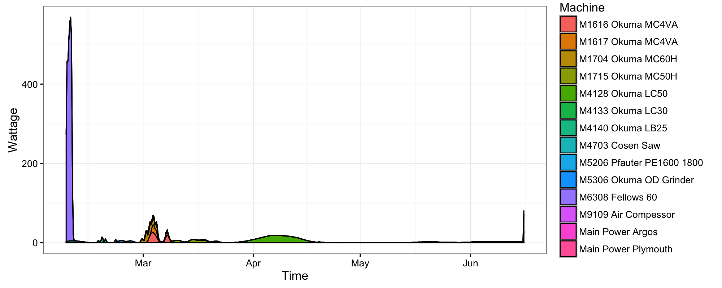
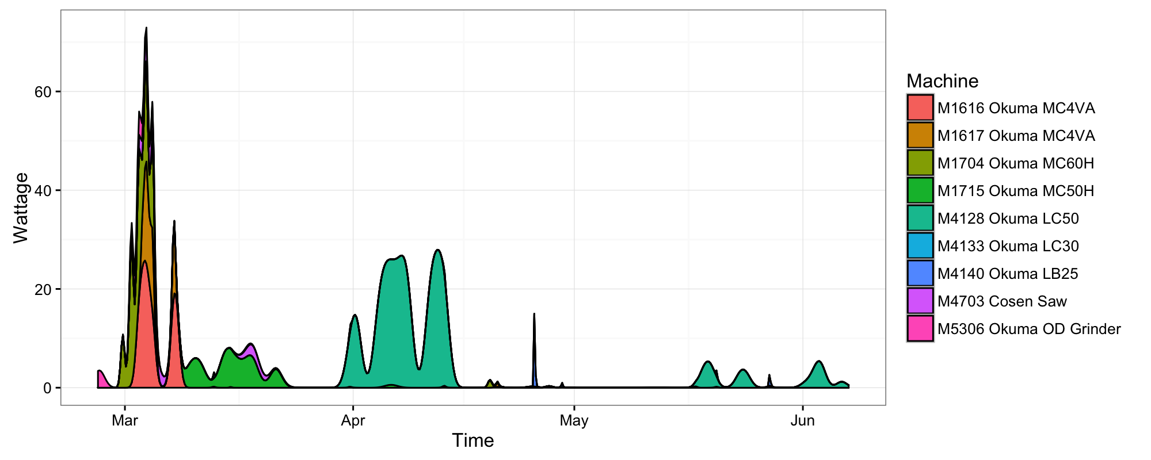
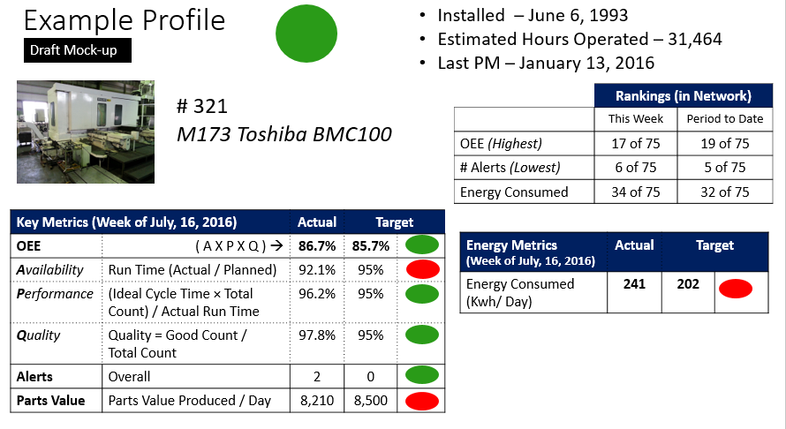

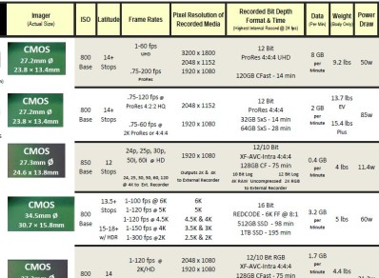
Three key elements of Business Intelligence
1
GRID
75 Machines
2
LIST
Lines of data detail
Data Panels ->
J F M A
Buttons->
3
DRILL DOWN

Slide 8
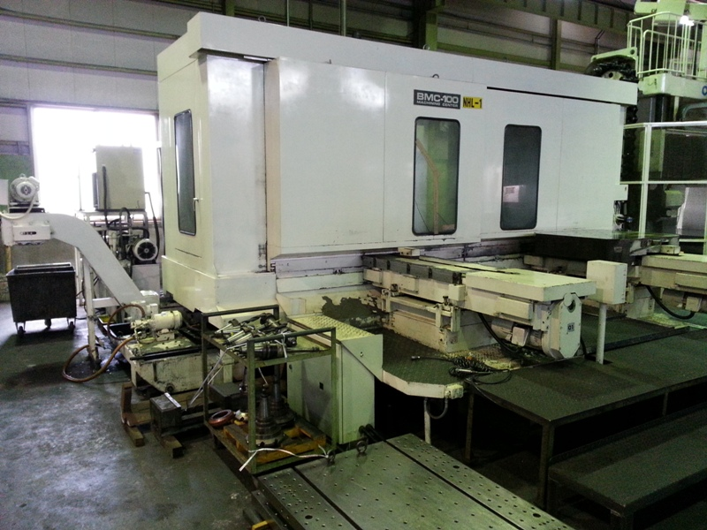
Example Profile
Installed – June 6, 1993
Estimated Hours Operated – 31,464
Last PM – January 13, 2016
Draft Mock-up
# 321
M173 Toshiba BMC100
 | Rankings (in Network)
 | This Week | Period to Date
OEE (Highest) | 17 of 75 | 19 of 75
# Alerts (Lowest) | 6 of 75 | 5 of 75
Energy Consumed | 34 of 75 | 32 of 75
Key Metrics (Week of July, 16, 2016) |  | Actual | Target
OEE | ( A X P X Q ) → | 86.7% | 85.7%
Availability | Run Time (Actual / Planned) | 92.1% | 95%
Performance | (Ideal Cycle Time × Total Count) / Actual Run Time | 96.2% | 95%
Quality | Quality = Good Count / Total Count | 97.8% | 95%
Alerts | Overall | 2 | 0
Parts Value | Parts Value Produced / Day | 8,210 | 8,500
Energy Metrics (Week of July, 16, 2016) | Actual | Target
Energy Consumed (Kwh/ Day) | 241 | 202

Slide 9
Slides Not Used Why Business Case

Slide 10

Lots of data is collected daily…

Slide 11

…yet, so little of it is effectively used for insights

